Slide 1

Introduction
Features
AdaBoost
Cascade
Harbin Institute of Technology
Rapid Object Detection Using a Boosted Cascade of Simple Features
巩固
2190400605
2022.4.7

Slide 2
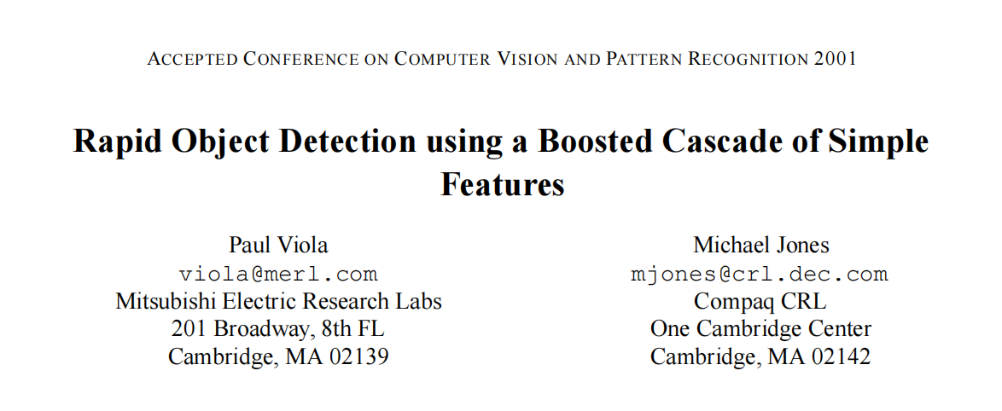
background
Model Implementation
Results
Introduction
Features
AdaBoost
Cascade
Harbin Institute of Technology
Introduction

Slide 3
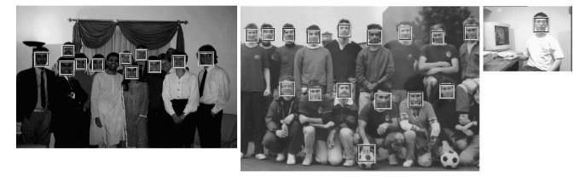
background
Model Implementation
Results
Introduction
Features
AdaBoost
Cascade
Harbin Institute of Technology
Introduction

Slide 4
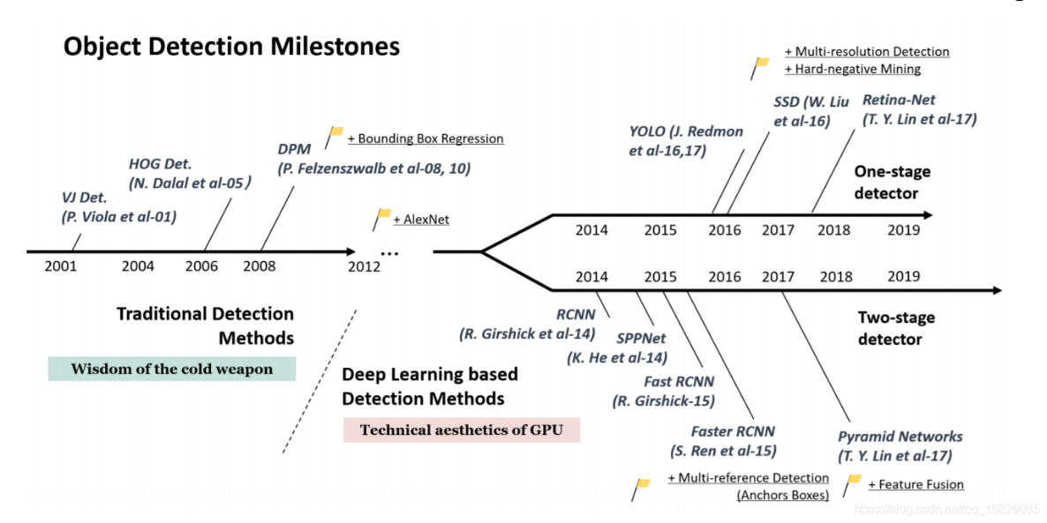
background
Model Implementation
Results
Introduction
Features
AdaBoost
Cascade
Harbin Institute of Technology
Introduction

Slide 5
background
Model Implementation
Results
Introduction
Features
AdaBoost
Cascade
Harbin Institute of Technology
Introduction
integral image 积分图
AdaBoost 特征选择
Cascade 级联

Slide 6
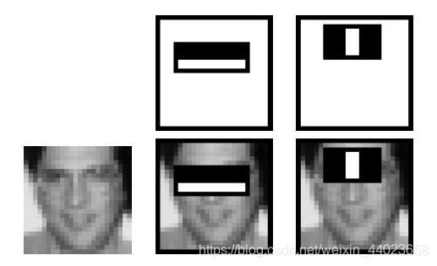
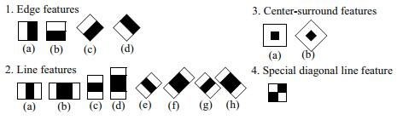
background
Model Implementation
Results
Introduction
Features
AdaBoost
Cascade
Harbin Institute of Technology
Features
特征值= 像素之和 - 像素之和

Slide 7
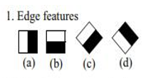



background
Model Implementation
Results
Introduction
Features
AdaBoost
Cascade
Harbin Institute of Technology
Features
如何快速计算那么多的特征？
哪些矩形特征才是对分类器分类最有效的？

Slide 8
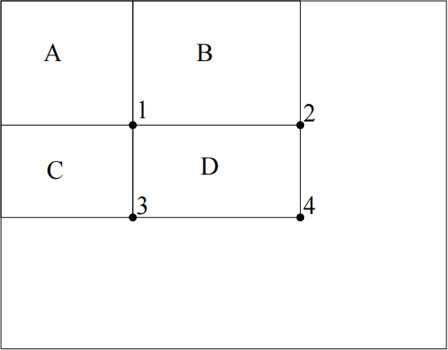
background
Model Implementation
Results
Introduction
Features
AdaBoost
Cascade
Harbin Institute of Technology
Features
如何快速计算那么多的特征？
A = 1
B = 2 - A = 2 - 1
C = 3 - A = 2 - 1
D = 4 - A - B - C = 4-2-3+1
积分图（Integral Image）
只遍历一次图像就可以求出图像中所有区域像素和
1 | 2
3 | 4
1 | 2+1
3+1 | 4+(2+1)+(3+1)-1

Slide 9
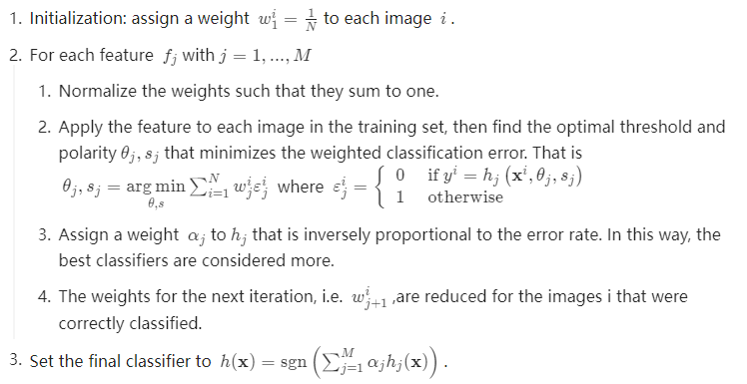
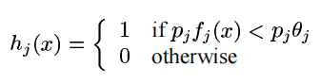
background
Model Implementation
Results
Introduction
Features
AdaBoost
Cascade
Harbin Institute of Technology
AdaBoost
Adaptive boosting(自适应增强)是一种迭代算法，其核心思想是针对同一个训练集训练不同的弱分类器，然后把这些弱分类器集合起来，构成一个强分类器。
哪些矩形特征才是对分类器
分类最有效的？
特征值
阈值
不同的训练照片会有不同的权重，包含人脸越多的照片权重越大。
逐个特征进行迭代，迭代过程中训练出相应特征值的阈值。
每个特征都相当于一个弱分类器，经过迭代，都会得到相应的权重，权重与识别错误率成反比。

Slide 10
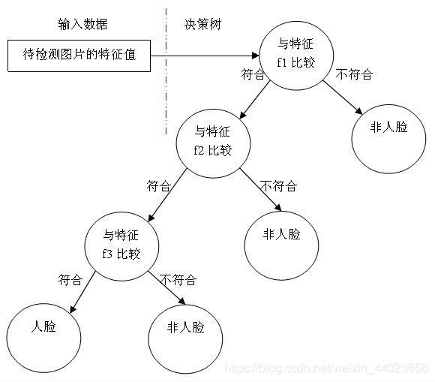
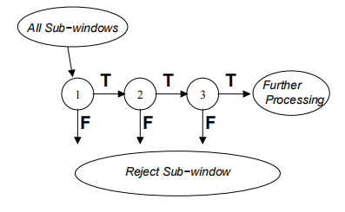
background
Model Implementation
Results
Introduction
Features
AdaBoost
Cascade
Harbin Institute of Technology
Cascade

Slide 11
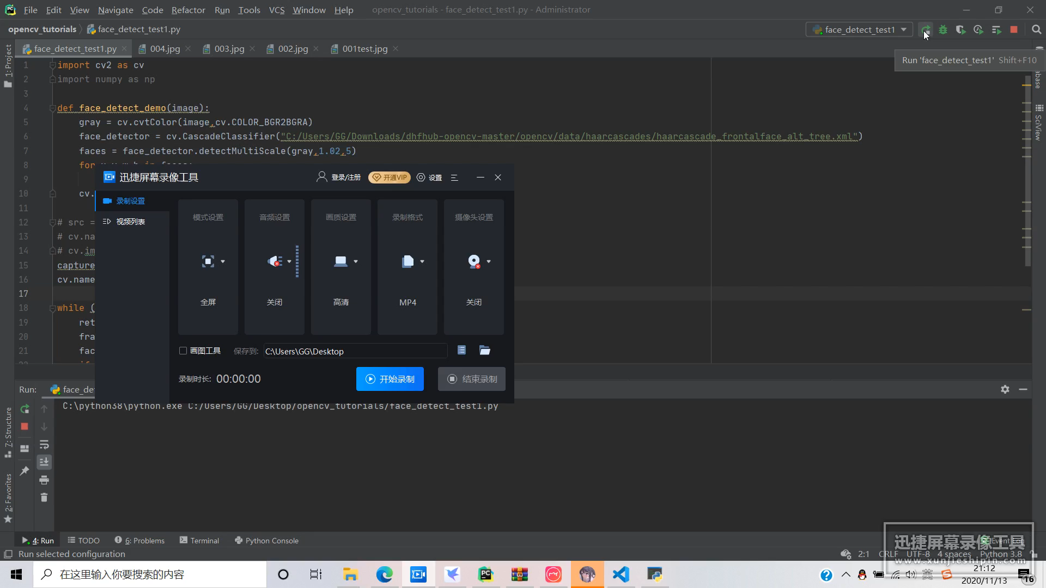
background
Model Implementation
Results
Introduction
Features
AdaBoost
Cascade
Harbin Institute of Technology
End

Slide 12
background
Model Implementation
Results
Introduction
Features
AdaBoost
Cascade
Harbin Institute of Technology
End
选择Haar Feature特征模板
遍历图像，创建积分图
Adaboost训练
构建级联分类器

Slide 13
background
Model Implementation
Results
Introduction
Features
AdaBoost
Cascade
Harbin Institute of Technology
End
Thank You!

